Slide 1
A Service Oriented Architecture (SOA) Primer

Slide 2
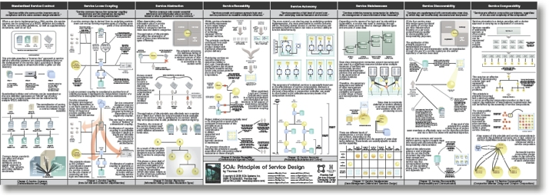
SOA as an Architectural Style
SOA = Service Oriented Architectures: Why the “A” in SOA represents an Architecture Style versus an Architecture Pattern or something else
Architecture Style = components and connectors that are used together with a collection of constraints
Architecture style provides the foundation for a collection of solution patterns
Materials summarized from http://www.eaipatterns.com/docs/SOAPatterns.pdf

Slide 3
When do we use a SOA Style?
Context: A number of services are offered (and described) by service providers and consumed by service consumers. Service consumers need to be able to understand and use these services without any detailed knowledge of their implementation.
Problem: How can we support interoperability of distributed components running on different platforms and written in different implementation languages, provided by different organizations, and distributed across the Internet?
Solution: The service-oriented architecture (SOA) pattern describes a collection of distributed components that provide and/or consume services.
From “Software Architecture In Practice” Len Bass, Paul Clements, Rick Kazman

Slide 4
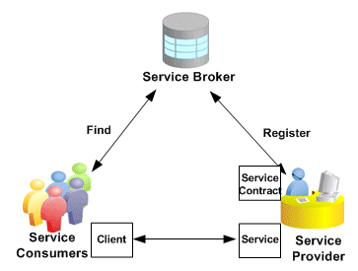
What does a “traditional” service oriented architecture look like?

Slide 5
Why SOA?
Modern application architectures are almost always distributed, we desire an architecture approach to construct applications using a collection of autonomous services.
Focus of design is on integration – individual services could be developed and deployed using different technology stacks and platforms. Integration patterns are selected that use messaging
Desire to reuse well known OO principles such as encapsulation, abstraction, and well-defined interfaces in creating new architectures based on SOA
Availability and stability of services influence design decisions – separate core aspects of building the service (not likely to change) from the service configuration (likely to change)
The desire to easily integrate capabilities built and hosted by others into our own applications

Slide 6
What does a typical SOA inspired solution look like?

Slide 7
What design models does a SOA promote?
Composition
Robust structures are built up from granular components
Process-Orchestration
Orchestration logic is used to coordinate the interaction between multiple services
Declarative
Express the logic of computation without hard-coding the control flow
Focus is on designing “what” should be done within the realm of the problem domain, versus “how” to go about accomplishing it
Event-Driven
Message-based communication is used to trigger actions based on interesting events
SOA based systems trigger and react to events versus hard coding what happens and in what order it happens

Slide 8
Almost too good to be true
Doesn’t account for latest thinking around Smart endpoints and dumb pipes versus “smart pipes”
https://medium.com/@nathankpeck/microservice-principles-smart-endpoints-and-dumb-pipes-5691d410700f
https://martinfowler.com/articles/microservices.html
Hard to scale
Hard to make resilient
Hard to make performant
Hard to evolve
Fragile to change

Slide 9
The good and bad parts of traditional SOA
The good parts
Composition
Robust structures are built up from granular components
Process-Orchestration
Orchestration logic is used to coordinate the interaction between multiple services
Declarative
Express the logic of computation without hard-coding the control flow
Focus is on designing “what” should be done within the realm of the problem domain, versus “how” to go about accomplishing it
Event-Driven
Message-based communication is used to trigger actions based on interesting events
SOA based systems trigger and react to events versus hard coding what happens and in what order it happens
The not so good parts

Slide 10
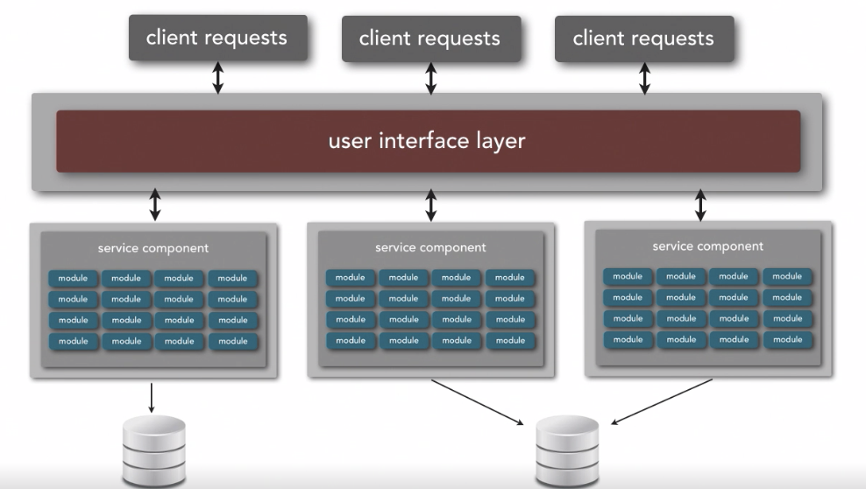
Service Based Style
Ref: Neil Ford & Mark Richards Software Architecture Fundamentals
Think of SOA, “the good parts”

Slide 11
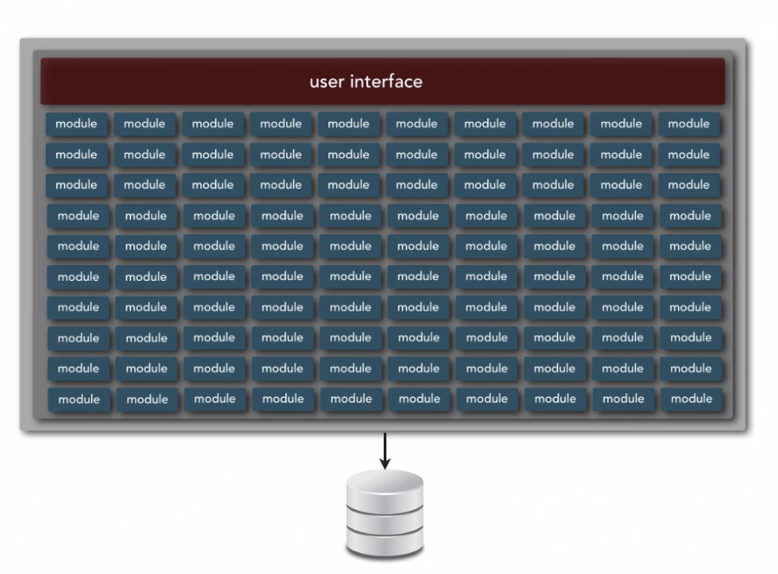
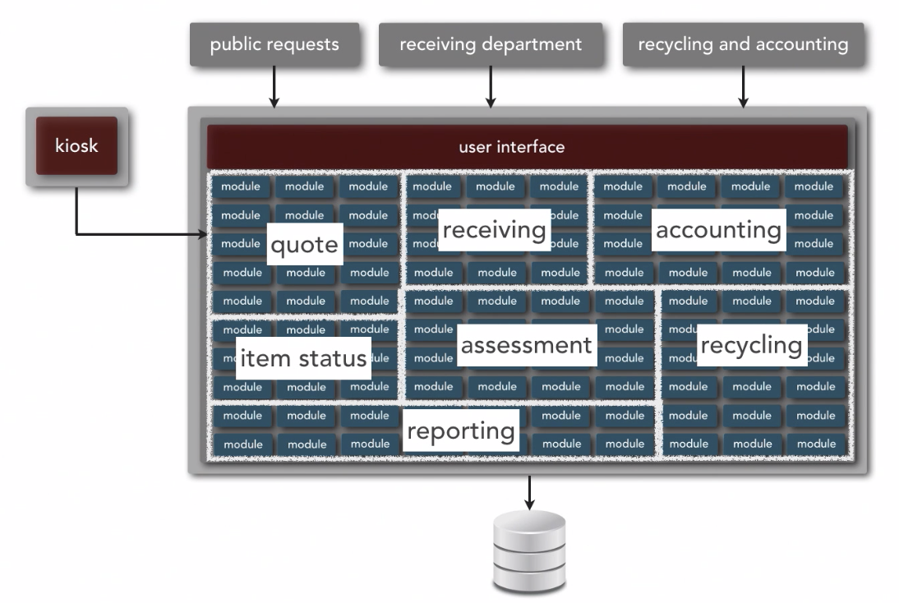
Service Based Style - Example
Ref: Neil Ford & Mark Richards Software Architecture Fundamentals
Generally Good To Decompose a Monolithic Application

Slide 12
Tenets of SOA – Boundaries are Explicit
A boundary represents the border between the services interface and its internal private representation
Interaction via messages is used to cross well-defined boundaries
A boundary is used to abstract certain factors such as geography, trust, or execution complexity
A SOA-based design needs to account for the opaque aspects of crossing boundaries
The physical location of the service is unknown and should not matter
Security models and policies are enforced as boundaries are crossed
Marshalling and casting data structures from the services public interface to private internal representations might require additional resources
The service consumer is likely to have no knowledge of the internal service implementation and therefore has no control over certain service execution aspects such as performance
The distributed nature of crossing service boundaries introduces multiple opportunities for errors, thus error processing must be robust

Slide 13
Tenets of SOA – Services are Autonomous
Services are entities that can be independent deployed, versioned and managed
Services are dynamically addressable through a well known URI
The physical location of the service can change with the expectation of not impacting the consumer
If the service relies on another service, it should not use the service client to bridge this dependency
Both service consumers and service providers should take a pessimistic view of performance and the behavior of the other party
Service consumers should be able to time-out and appropriately deal with a slow response times
Service providers should assume that service consumers might misuse the service (accidently or maliciously) and be hardened to deal with these issues

Slide 14
Tenets of SOA – Services Share Schema and Contract, not Class
Services interaction should be based solely on the services interface contract (versions, discovery, policies, message-formats/schemas, behaviors)
Implementation details of a service (the class structure used to construct the service) are independent from the interface used to invoke the service
The key to designing good services, is designing good service interfaces
They are hard to change – may break existing service consumers
They can introduce performance challenges – transforming between the service interface and native interface can be expensive
Consumers must not only know the structural aspects of the interface but also the policies that govern the service implementation

Slide 15
Tenets of SOA – Service Compatibility is based on Policy
Service interfaces define the structural contract for interfacing with a service, policies define the semantic aspects of interacting with a service
Policies govern the behavior and expectations of a particular service, example:
Before a new user is created, the ID must be unique
Services supporting external users should be given more priority than services supporting internal applications
A secure service must adhere to a set of required security policies (e.g., OAuth, mutual auth, etc)
Messages received by a service must be encrypted in a certain way
Messages can be accepted over a queue or HTTP

Slide 16
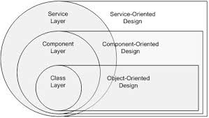
Designing for SOA – build upon previous knowledge in OOD and COD

Slide 17
Characteristics of the SOA Style
Characteristic | Traditional Architectures | SOA Architectures
Design & Implementation | Function Oriented Designed to Last Long development cycles Integration with other applications difficult | Coordination Oriented Built for Change Build and deployed incrementally Ease of integration with other applications
Physical System | Application boundaries intrinsic to system Tightly coupled components Object- or Component-oriented interactions | Enterprise solutions Loosely coupled Semantic message-oriented interactions
SOA-based architectures have been around for a long time and have matured over the years. While once an approach to manage design and integration complexity - SOA-based architectures have matured to the point where many companies are starting to offer service-only solutions (APIs) leaving the build of interesting applications to others. See: https://apigee.com/console/others

Slide 18
Ingredients needed to create applications using the SOA style
A set of services that is thought to be of value to customers, partners, or other areas of an organization
An architectural style that requires a service provider, mediation, and service requestor with a service description
A set of architectural principles, patterns and criteria that address characteristics such as modularity, encapsulation, loose coupling, separation of concerns, reuse and composability
A programming model complete with standards, tools and technologies that supports web services, REST services or other kinds of services
A middleware solution optimized for service assembly, orchestration, monitoring, and management
Adopted from: http://www-01.ibm.com/software/solutions/soa/

Slide 19
Service Oriented Architecture is an Example of an Architectural Style
An Architectural Style defines a family of systems in terms of a pattern of structural organization.
What are the architectural components?
What are the architectural connectors?
What patterns guide the design of the components and connectors?
How are faults and unexpected events handled?
Clear definition of the set of constraints on the architectural components and the relationships that are allowed between them
Because SOA is an Architectural Style a Reference Architecture can be constructed to govern common aspects of all applications built in accordance with this style… see: http://www.opengroup.org/soa/source-book/soa_refarch/intro.htm

Slide 20
Service Oriented Architecture is an Example of an Architectural Style
SOA as an Architectural Style:
What are the architectural components?
Services
What are the architectural connectors?
Messages
What patterns govern the design of the components and connectors?
Data Services, Business Services, Composite Services
How are faults and unexpected events handled?
Language specific exception handling mapped to service faults (SOAP)
HTTP Error Codes – 400 Series (REST)
Clear definition of the set of constraints on the architectural components and the relationships that are allowed between them
Services are network addressable
Services are language and platform independent
Services have flexible instantiation capabilities
Services are stateless
Messages are formally defined by a service contract
…

Slide 21
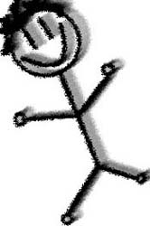
The “Actors” in an SOA – Service Consumers, Service Providers & Messages
Message
Service Provider
Service Consumer
Concrete Service
Application
Intermediary Service
Service
Consumed Service Interface
Provided Service Interface

Slide 22
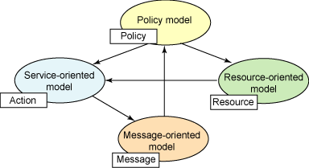

The SOA Model from the W3C
The Service Model is dependent on other models. The Message Model defines the messages that a service can accept (content, body, protocol, etc); the Resource Model defines the resources used to fulfill the service contract and are hidden from outside consumers of the service; the Policy Model defines constraints on allowable actions or states and is the enforcement point for security.
http://www.ibm.com/developerworks/architecture/library/ar-soastyle/

Slide 23
The Architectural Components - Services
Services are a conceptual design component, and can be implemented using a variety of different technologies
Java (via frameworks – Play, Spring, Restlet, etc)
Scala (via frameworks – Play, Spray, etc)
.Net
Javascript frameworks such as Node.js
Even Python, COBOL or just about any other language these days
Third party tools: Siebel, Salesforce
Services are designed to have flexible interfaces and are evolved easily
Services separate the concerns of the service consumer from the service provider
Services can be instantiated in a variety of different ways
Local components, Web Services, Sync-/Asynchronous Messages
Services are lifecycle managed by an application server container of some sort
CICS, .Net Framework, Java (WebSphere, Tomcat), Node.js, Vert.x, etc.

Slide 24
The Architectural Components - Services
Service Boundary
Service Endpoint / Controller
Service Models
Service Boundary
Service Interface
U

Slide 25

The Architectural Connectors - Messages
Services interoperate with each other using “messages” capable of verifying and certifying their own syntax and semantics
Architecture Requirements for Messages
Messages do not assume any sort of delivery technology
Messages support intermediaries and can be transformed between the service consumer and the service provider without either party being aware of the transformation process
Messages can be secured end-to-end
Messages can be deserialized into language-specific components
Language specific components can serialize themselves into a valid message that adheres to both the syntactic and semantic requirements of the message

Slide 26
Service Integration Styles
Service consumers can be wired to service providers using both synchronous and asynchronous messaging
Patterns can be request-reply or subscription based
 | One | Many
Synchronous | Try[T] | Iterable[T]
Asynchronous | Future[T] | Observable[T]

Slide 27
Example of a Synchronous-One Pattern
Service Provider
Service Consumer
def CallService(req:ReqObjType) : RespObjType = { try{
val respObj : RespObjType = doSomething(req)
respObj
}
catch (e: Exception) { throw new Exception(e)
}
}
val req : ReqObjType = {…}
try{
val respObj : RespObjType = CallService(req);
//process respObj } catch(e: Exception) { println(e.toString()) }

Slide 28
Example of an Asynchronous One Pattern
Service Consumer
Service Provider
val req : ReqObjType = {…}
val f : Future[RespObjType] = future { callService(req) }
f onSuccess{ case respObj:RespObjType => { /* process respObj */ }
}
f onFailure{ case e:Exception => { /* handle e*/ }
}
def CallService(req:ReqObjType) : Future[RespObjType] = future { try{ val respObj : RespObjType = doSomething(req);
respObj }catch (e:Exception) {
throw new Exception(e)
}
}

Slide 29
Example of the Synchronous Many (Iterable) Pattern
Service Provider
Service Consumer
Call Service →
def CallService(req:ReqObjType) = { val respObjCollection : RespObjTypeColl = doSomething(req);
//get an iterator from the collection
val it= respObjCollection.iterator()
try{
while(respObjCollection.hasNext)
it.onNext(respObjCollection.next()
it.onCompleted()
}
catch (e:Exception) {
it.onError(e)
}
}
val req : ReqObjType = {…}
val respObj : RespObjTypeColl = CallService(req);
try{ while(respObj.hasNext) doSomething(respObj.next())
}
catch(e: Exception){
//process exception
}
← onNext()
← onNext()
← onNext()
← If error onError(E)

Slide 30
Example of the Asynchronous Many Pattern (Streams)
Observer as stream
Service Consumer
Service Provider
val req = “NewCustomerArrives”
val respObjserver: Observer[RespObjItem] = CallService(req).subscribe()
respObserver onNext( item => { //process next item
}
respObserver onCompleted {
//handle when done note that //the stream might be infinite
}
respObserver onError( e => {
//process error, exception in e
}
//after some time respObserver.unsubscribe()
def CallService(listenOn:String) : Observable = {
Observable.create( observer => { val service = lookupService(listenOn) { def somethingHappened( e: Event) =
observer.onNext(e)
def serviceFinished = observer.onCompleted()
def serviceError (err: Throwable) = observer.onError(err) } observer.subscribe(service)
new Subscription{
override def unsubcribe = observer.unsubscribe(service)
}
}
}
subscribe()→
← onNext()
← onNext()
← onNext()
← If error onError(E)
unsubscribe()
Note that this pattern can also apply to subscribing to server streams that are unbounded in length

Slide 31
Example showing how an Interable can be converted to an Observable
Service Provider
Service Consumer
Call Service →
def CallService(req:ReqObjType) : Observer[RespObjItem] = { val respObjCollection : RespObjTypeColl = doSomething(req);
Observable[RespObjItem] (observer => {
try{
while(respObjCollection.hasNext)
observer.onNext(respObjCollection.next())
observer.onCompleted()
}
catch (e:Exception) {
observer.onError(e)
} })
}
val req : ReqObjType = {…}
val respObjserver: Observer[RespObjItem] = CallService(req);
respObserver onNext( item => { //process next item
}
respObserver onCompleted {
//handle when done
}
respObserver onError( e => {
//process error, exception in e
}
← onNext()
← onNext()
← onNext()
← onCompleted()
← If error onError(E)

Slide 32
Service Types – Stateful and Stateless
Stateless – every call is independent
Statefull – current call depends on state of previous call(s)
Service Consumer
Service Provider
y = serviceCall(x);
x.lastName = “newLast”;
z = serviceCall(x);
serviceCall(); { … }
Service Provider
Service Consumer
serviceCall(); {
mySession = getState(req.session); …
resp.session = saveState(mySession);
}
Session Store
y = serviceCall(x);
x.lastName = “newLast”;
x.session = y.session;
z = serviceCall(x);
To improve scalability stateless is preferred over stateful services

Slide 33
The Architectural Components – Messages - Request
<soapenv:Envelope xmlns:soapenv="http://schemas.xmlsoap.org/soap/envelope/" xmlns:com="http://com.drexel.ws.messages">
<soapenv:Header/>
<soapenv:Body>
<com:PublicationRequest>
<com:RequestType>
<com:GetAll></com:GetAll>
</com:RequestType>
</com:PublicationRequest>
</soapenv:Body>
</soapenv:Envelope>
Service Consumer
Service Implementation
U

Slide 34
The Architectural Components – Messages - Response
U
<SOAP-ENV:Envelope xmlns:SOAP-ENV="http://schemas.xmlsoap.org/soap/envelope/">
<SOAP-ENV:Header/>
<SOAP-ENV:Body>
<ns2:PublicationResponse xmlns:ns2="http://com.drexel.ws.messages">
<ns2:Article id="1">
<ns2:Title>title</ns2:Title>
<ns2:AuthorList>
<ns2:Author>Brian</ns2:Author>
<ns2:Author>Ben</ns2:Author>
</ns2:AuthorList>
<ns2:Cite>by xxxx</ns2:Cite>
<ns2:PubDate>10/10/2010</ns2:PubDate>
<ns2:Abstract>abstract</ns2:Abstract>
<ns2:PubLink>http://xxx.yy.com/xxx.pdf</ns2:PubLink>
</ns2:Article>
</ns2:PublicationResponse>
</SOAP-ENV:Body>
</SOAP-ENV:Envelope>
Service Consumer
Service Implementation

Slide 35
The Architectural Components – Messages – Request/Response REST
GET http://localhost:3000/papers/2
U
{
"id": 2,
"title": "On the Automatic Modularization of Software Systems Using the Bunch Tool",
"cite": "B. S. Mitchell, S. Mancoridis In the IEEE Transactions on Software Engineering, Volume 32, Number 3, 2006, pp. 193-208.",
"link": "pubs/TSE-0035-0304.pdf",
"slides": null,
"abstract": "Since modern software systems are large and complex, appropriate abstractions of their structure are needed to make them more understandable and, thus, easier to maintain. Software clustering techniques are useful to support the creation of these abstractions by producing architectural-level views of a system’s structure directly from its source code. This paper examines the Bunch clustering system which, unlike other software clustering tools, uses search techniques to perform clustering. Bunch produces a subsystem decomposition by partitioning a graph of the entities (e.g., classes) and relations (e.g., function calls) in the source code. Bunch uses a fitness function to evaluate the quality of graph partitions and uses search algorithms to find a satisfactory solution. This paper presents a case study to demonstrate how Bunch can be used to create views of the structure of significant software systems. This paper also outlines research to evaluate the software clustering results produced by Bunch."
}
Service Consumer
Service Implementation

Slide 36
Approaches to Identify Services in a SOA Design
1. Business Process Decomposition
Businesses can be viewed in terms of their primary processes, these processes can be further subdivided into sub-processes, and then decomposed again into very granular processes. These are typically called the L1, L2, and L3 processes
The L3 processes are “logical units of work” that support the business
Logical units of work have a clear input, output and rules that transform inputs into outputs – these can be services
Example: EnrollCustomerInLoyaltyProgram
2. Business Functions
Similar to business processes, many organizations operate using a collection of business functions
Designing around business functions are less likely to be biased by the way the business processes were implemented.
A function takes the form of y = f(x) where inputs “x” are transformed into a well defined output(s).
Example: ProcessCustomerPayment(x) applies x dollars against the customers account

Slide 37
Approaches to Identify Services in a SOA Design
3. Look for “Business Entity” Objects in the problem domain
Most SOA solutions operate on data. Objects in an OOD work at the table level
SOA components operate at the business object level
Look for key business entities in the application domain from the perspective of (C)reate, (R)ead, (U)pdate, or (D)elete operations.
Examples: Customer, Payments, Order, etc
4. Look at “Ownership and Responsibility” to leverage reusable services built by others (where it makes sense)
This SOA design attribute is less about identifying a service, and more about identifying who builds, owns and maintains the service.
Many SOA applications are “mash ups”, combining services from different parties.
When identifying a service, look for opportunities to reuse services that are offered by others when they are not key to differentiating you application.
Example: If you need a service for mapping or geo-coding would you build this yourself, or would you integrate a service offered by google?

Slide 38
Approaches to Identify Services in a SOA Design
5. Goal-Driven Service identification
Identify goals of your business or application that can be realized via automated support.
Example: Goal: “Improve customer transparency into service pricing”; Service: create an “Estimator” service that allows customer to estimate costs before they make a purchase decision
6. Component-Based
Use a traditional software engineering approach to identify services
Create a conceptual architecture view of the target application
Look for natural boundaries that adhere to the principles of maximizing cohesion and minimizing coupling.
These identify candidate components
For each candidate component see if they well defined responsibility, clear ownership, and if they can be distributed to run in different address spaces
Example: The bunch software clustering tool offers a clustering service where the modularization quality calculation is externalized as a service.

Slide 39
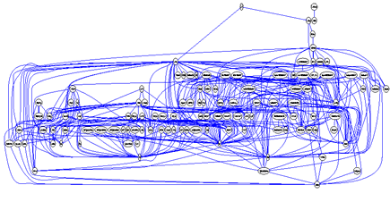
Component-Based Decomposition Example – The bunch system
Here is the module interdependencies of the bunch system. Not much is apparent…

Slide 40
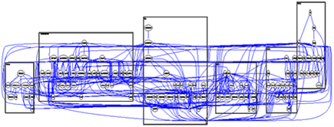
Component-Based Decomposition Example – The bunch system
Here is the module interdependencies of the bunch system. Lets run bunch itself to cluster the system to look for some candidate subsystems…

Slide 41
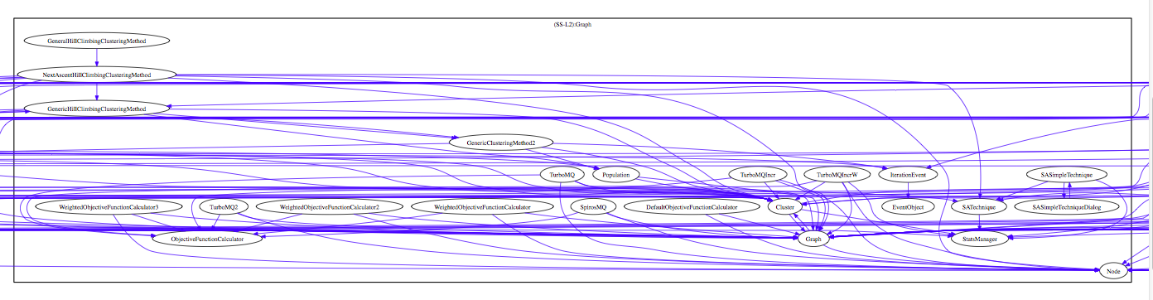
Component-Based Decomposition Example – The bunch system
This one looks promising – it has a lot of functionality related to evaluating the modularization quality function. Domain knowledge also tells us that its compute intensive so it might make for a good service…

Slide 42
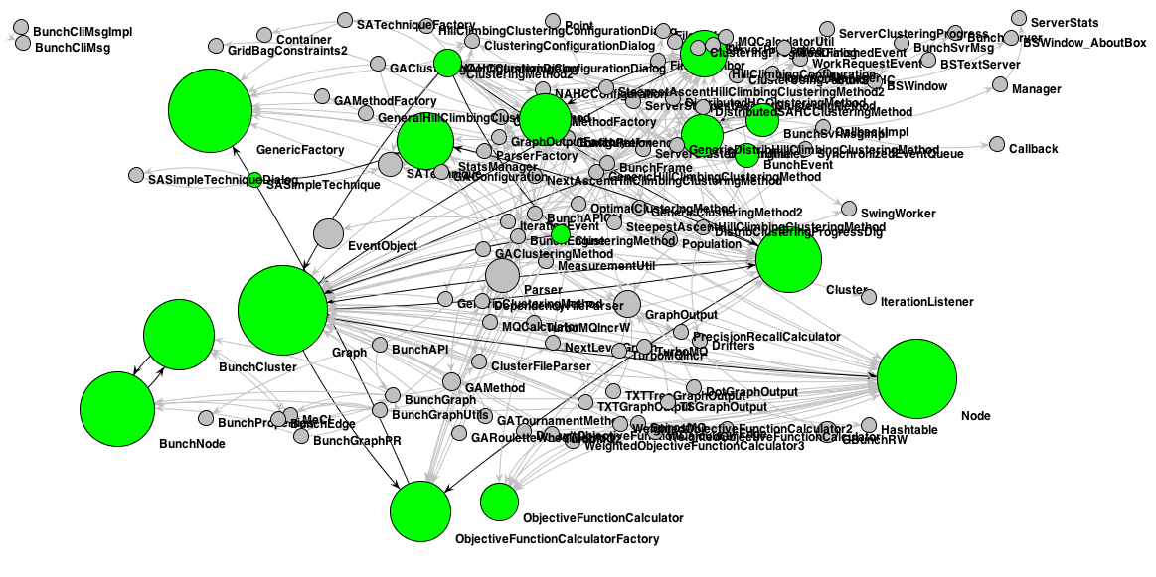
Component-Based Decomposition Example – The bunch system
This looks promising because another tool that I wrote that runs some importance algorithms identifies some of these classes as important.

Slide 43
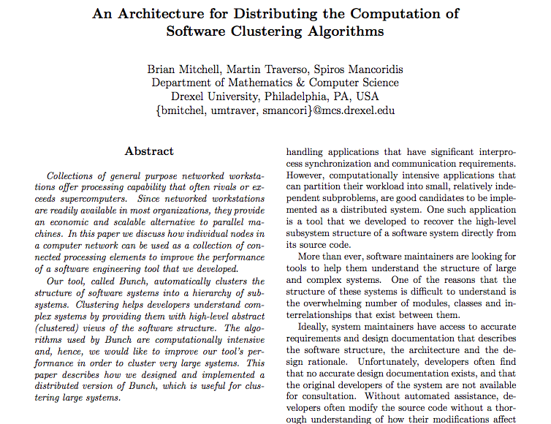
We refactored bunch to support distributed computation and describe it here…

Slide 44
Approaches to Identify Services in a SOA Design
7. Existing Supply – Refactoring into a SOA
Look at existing inventory of applications and how they work together
Identify existing integration interfaces – API calls, Database Transactions, Database Queries
Select integration points that can be migrated away from using existing integration patterns into a SOA pattern
Example: Refactor an application that supports customer service, identify all ODBC and SQL calls that related to customer management, refactor by creating a SOA service for “Customer”
8. Front Office Application Usage Analysis
Most enterprise have multiple applications that have some underlying redundant functionality – typically this functionality is implemented differently in each application.
Identify these redundant functions and see if they can be encapsulated into a common service.
Example: Drexel grading data is used by students, facility and the administration – it can be accessed via the web, but we would like to extend to mobile. Solution is to create a common grading service that can be used by multiple applications. Imagine a service like “HoldGrades()” that is called from the billing system

Slide 45
Approaches to Identify Services in a SOA Design
9. Infrastructure
Although not common, there are cases when services are useful to take advantage of sharing infrastructure-specific capabilities.
Consider that you have a special piece of hardware that performs a very specific function and you want to share that capability with a lot of consuming applications.
Consider when you need to isolate a specific function to a certain piece of hardware or network zone for compliance purposes
Create a service that hides the specifics of the special infrastructure and expose it to other applications. Example: Use PayPal’s payment services instead of doing your own credit card processing – eliminates the need to deal with PCI compliance.
10. Look at non-functional requirements.
Examine the set of non-functional requirements and look for opportunities where centralizing the implementation of certain capabilities helps enable the non-functional requirements.
Common examples are from security and performance set of non-functionals.
Example: Create a service to encapsulate making authorization decisions abstracting the complex dataflow of the oAuth protocol; another example is the distribution of the MQ calculation in the Bunch tool (from Method #6)
Reference: “Ten Ways to Identify Services”, http://searchsoa.techtarget.com/tip/Ten-ways-to-identify-services

Slide 46
Lets Try To Design- Example: Online “Secure” Wallet App
Problem Statement: The goal of the application is to design a secure online wallet application. The application should:
Allow a user to login, create and manage a profile
Allow a user to manage various security and financial instruments:
Bank and investment account information (account numbers, account types, security credentials)
Credit Card Information (accounts, numbers, expiration dates) to support automated payments
Website credentials (website address, user ids, passwords)
Loyalty card programs (card types, account numbers, etc)
Frequent flyer account information
All information at rest and transmitted should be encrypted
Access to the application is via a single strong password
Secondary passwords can be used to secure additional account information access
Application should be designed so that it can be accessed over the web and via mobile devices
Questions: Why is this application a good candidate to be implemented using a SOA pattern?
What are the key components and connectors?

Slide 47
Specialization of SOA Models
Contract/Operation Based (SOAP)
Service is defined in terms of operations that the service can perform, the messaging frameworks that the service supports, and a strict definition of the data structures supported by the service operations (request and response)
The service contract is specified in a special XML document, called a WSDL document
The WSDL document can also specify policies associated with using the service.
Contract can be loosely- or strictly- enforced
Lots of extensions, defined as WS-* standards
Messaging typically in the form of XML documents
Resource Based (REST),
First introduced in 2000 by Roy Fielding’s Ph.D. thesis
Service is defined in terms of resources (generally nouns)
Service operations are mapped to HTTP verbs
Service runtime utilizes web runtime, in fact they cant be distinguished
Messaging typically in the form of JSON documents, although XML is also used
Example-based versus contract-based specification. Some work on this with the WADL specifications.
Up until a few years ago SOAP was the more popular approach; however, now RESTful services are dominating SOA-based architecture…
We will also look at very recent advancement of SOA patterns later in the course – Reactive, Graph Query, etc.

Slide 48
Specialization of SOA Models
GraphQL
Open-sourced by Facebook
Strongly typed schemas
A JSON based query language
gRPC
Open Sourced by google
Based on Protocol Buffers
Binary and very fast
https://graphql.org/
https://grpc.io/

Slide 49
SOA Requirements around the Runtime Stack
SOA services generally run within a framework to provide a number of useful capabilities:
Network – TCP/IP, HTTP/S, HTTP2
Serialization – objects to/from XML or JSON (or Binary)
Thread Management – allocating threads to services or providing an async framework (remember the reactor pattern).
Security – best practice is to externalize security from the service implementation. This includes user management (authentication/authorization) as well as defending against DoS and injection attacks

Slide 50
The runtime containers for web services come in two flavors
Traditional
Async
Servlet Container
Embedded Container
Web Container
Web Service
Service Interface
Web Service
Service Interface

Slide 51
And most recently a third option is arising Microservices
Package eg, WAR,
.tar.gz
Service Interface
Web Service
Integrated Container
Additional information on Microservices can be found on Martin Fowlers website or looking at reference implementations like DropWizzard, Sprint Boot, or Docker

Slide 52
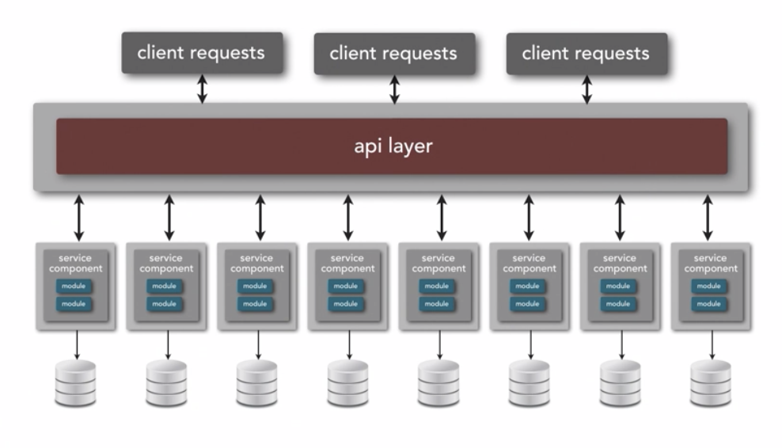
Microservice Architecture
Ref: Neil Ford & Mark Richards Software Architecture Fundamentals
Basic Idea – SHARE NOTHING

Slide 53
References
SOA Patterns, http://www.eaipatterns.com/SoaPatterns.pdf
“From Objects to Services: A Journey in Search of Component Reuse Nirvana” by M. Dodani, Journal of Object Technology vol3, no. 8, http://www.jot.fm/issues/issue_2004_09/column5.
“Service-Oriented Architecture : A Field Guide to Integrating XML and Web Services” by T. Erl, Prentice Hall , ISBN: 0131428985
“What Is An Enterprise Service Bus?”, by M. Gilpin, Forrester Research, http://www.forrester.com/go?docid=35193.
“Ten Ways to Identify Services”, http://searchsoa.techtarget.com/tip/Ten-ways-to-identify-services
Microservices, http://martinfowler.com/articles/microservices.html

